Slide 1


V
Cornell Systems Engineering
Model Based
Systems Engineering
Copyright Cornell University Systems Engineering, Dr. David R. Schneider 2016

Slide 2

Sample Mid-Review Presentation
(Short 10 Minute Version)
Being able to communicate your ideas as a designer is a crucial skill to develop. After all, what good is the best idea in the world if you can’t tell anyone about it or help them to understand why it is so great.
This sample presentation offers an example of the kinds of topics that should be addressed in a 10 minute professional mid-project review. There is a 1 hour version as well that is recommended for you review first, to help you learn how to trim.
Your own project may not be as far along as this sample project and that is perfectly fine. Your project may be farther along than this project and that’s fine too. The important thing is that you cover topics similar to the ones in this presentation:
Define Your Challenge So Someone Who Has Never Heard of It Can Understand
Introduce Your Solution and How it Meets the Challenge’s Needs
How Do You Measure the Performance / Success of Any Solution to this Challenge
What Has Been Done So Far & What is Your Current Solution’s Performance
What Issues and Risks Have Come Up and What Ones Remain
What are Your Next Steps, Your Projected End Deliverable & Its Performance

Slide 3
Project Background
The specific project this sample is developed around a college upperclassman full academic year design project that is presenting its work near the end of the 1st semester.
The danger in providing such an example is that some teams may try to match the topic chosen in the sample thinking that that is the kind of idea that “we are looking for”. This couldn’t be farther from the truth as we truly encourage a wide range of ideas to be submitted. To make this point even clearer, this sample is for a project that clearly could not be created: a Perpetual Motion Bicycle. (But if any of you are able to create a realistic perpetual motion machine we would be very interested in learning more about it.)
However, the challenge that the perpetual motion bicycle is trying to address is real, and the perpetual motion bicycle can be thought of as a “super” electric bicycle of today with some added novel technology. This is done to help you be able to follow the presentation better and . after all, if the fictitious can be explained in a effective way to you, hopefully it can help you understand how to communicate your real ideas effectively as well. In fact, many of the topics addressed and the methods used in this presentation translate very well to a professional, post-college, mid-project review that shows how the system was developed and how it works.
The amount of time spent on each topic may vary from project to project but this sample should provide some guidance. What the presenters would say for each slide is shown in the bottom notes section. Text that is written on the sides of the slides is additional commentary meant just for you, the reader. It may be better to review these insights after you’ve gone through the normal presentation at least once. If you still have questions, please be sure to make use of the additional on-line resources made available, such as the Cornell Cup On-line Q&A sessions.

Slide 4
But before we get started, remember…

Slide 5
DON’T
PANIC!

Slide 6
DON’T
PANIC!
This presentation shows that a lot of really good work was done prior to the presentation. You can do work to this level too! – or even better! And hopefully a presentation like this shows you want you are capable of. Many times, someone just needs to show us what goes into a great project to help us realize what we should & could be doing ourselves.

Slide 7

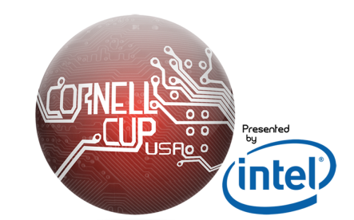
Some audiences will not appreciate “fancy fonts” and other similar aesthetics. It’s important to know your audience but even if they do like it, a consistency in style throughout your presentation can help make sure your slides are still “clean” looking and professional, which is typically more important than looking “fancy”.
Team Synergy Bike
Amelia Earhart
Jane Greatall
Tony Stork
Luke Skymoseier
Prof. Jones
We all like to show our school pride, but if you are doing this for the Cornell Cup Semi-Finals: do NOT include anything that signifies your school! -- like this Cornell Crest! The Semi-Finals are a “blind” review and that helps judges to judge the quality of your work on its own merits without any preconceptions. Indicating your school will hurt your score. (Please see the judging rubric)
Any connection to real individuals or events is completely coincidental
Intel Cornell Cup Semi-Finals– Jan. 19th 2015, 10:00 AM(EST)
Notes:
Good morning! We are Team Synergy Bike. We are very excited to introduce you today to an exciting sustainable solution for today’s commuters that has many of the benefits of a bicycle but is both faster and requires less user effort.

Slide 8
A (representational) picture like this one that helps to get the main idea across quickly, that also highlights key functions of your system, is sometimes referred to as an “Annotated Concept Sketch”. This can be one good way to introduce your idea
The Synergy Bike
Notes:
Synergy Bike appears much like a normal bicycle…

Slide 9
The Synergy Bike
Notice how the presentation only reveals the part of the slide that is being talked about. This is done to control the audience’s attention. Many audience members naturally read whatever is on a slide as soon as it is shown, and hence do not pay close attention to the speaking presenter. Since you want to make sure your ideas are heard, show only what you need, when you want.
Biker Inputs Energy on Flat & Downhill
Notes:
but as the rider pedals or gains speed on downhill sections, through a novel implementation of Perpetual Motion Controls (PMC) the Synergy Bike will be able to output greater effective energy than the rider has put into the system.

Slide 10
The Synergy Bike
Biker Inputs Energy on Flat & Downhill
Perpetual Motion Controls (PMC)
Helps on UpHills and with Speed
Notes:
helping the rider to overcome not only uphill sections but maintain a higher maximum speed.

Slide 11
The Synergy Bike
Biker Inputs Energy on Flat & Downhill
Cost Effective and Sustainable
Perpetual Motion Controls (PMC)
Helps on UpHills and with Speed
Notes:
This not only provides a cost effective and more sustainable solution for commuting and local errand needs…

Slide 12
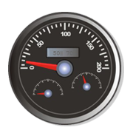
The Synergy Bike
Biker Inputs Energy on Flat & Downhill
“Cruise Control”
Cost Effective and Sustainable
Perpetual Motion Controls (PMC)
Helps on UpHills and with Speed
Notes:
but allows them to do it at a bike controlled speed faster than most cyclists average speed

Slide 13
This 5 minute version of the presentation demonstrates a variation on a more traditional order of presenting a project. Typically, the presentation description might start with a description of the problem that is being tried to be solved, as shown in the longer version of this presentation.
In this case, the broader transportation / commuting problem is already a familiar problem to most audiences. Hence, the audience can already at least partially understand the value of the presented solution and its innovations.
This quick overview of the solution was also chosen as a starting point since this is a 5 minute on-line video, and the novel nature and easily recognizable value that this solution offers is being used here to hook the audience to want to see more.
The Synergy Bike
Biker Inputs Energy on Flat & Downhill
“Cruise Control”
Cost Effective and Sustainable
Offer Health Benefits while Helping “Less than fit” Riders
Perpetual Motion Controls (PMC)
Helps on UpHills and with Speed
Notes:
While still offering riders the health benefits of pedaling to add in additional energy storage but only the amount they desire.

Slide 14
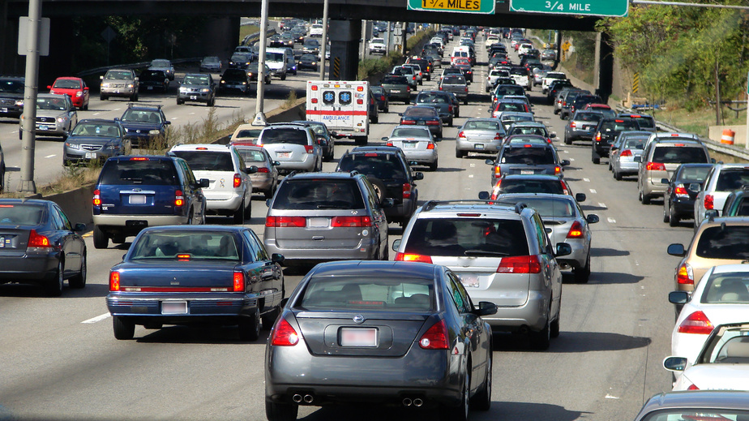
A good place to start, or at least someplace towards your presentation’s beginning, is with the general motivation of your work. Try to assume your audience understands the situation as little as possible. You may be used to presenting to a teacher who is already familiar with your problem, but in the real world no one will understand your project better than you – you are the expert and you need to help your audience understand its importance and value – even if it feels like you have to “hold their hand” at times, they will understand it better and appreciate your efforts.
Challenge Definition
Transportation
Here we start with a broad overview of an issue most people are familiar with and in the next slides, we begin to delve into the specific part of this problem that this project will be addressing.
Notes:
Right now, transportation is a major concern in today’s society. The frequent use and perceived need for resource-heavy and polluting automobiles is taxing our energy resources and environmental quality of life, as well as being a strain on the economy to upkeep these vehicles and the associated infrastructure.

Slide 15
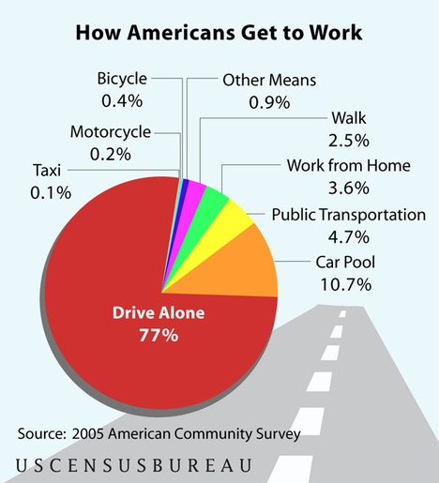

Commuting= Opportunity
Notice over the next few slides the transition from the broader familiar issue to the more focused scope of this presentation’s specific project and how the audience is shown how this specific project is important too with its relation to the initial familiar issue
Notes:
Right now, 77% of people drive to work alone.

Slide 16
Commuting= Opportunity
~88% of Commuters rely on Automobiles
Notes:
And when including car pooling and taxis nearly 88% rely on automobiles.

Slide 17

Showing the potential scope of the impact of your work is important to provide your audience perspective. Your impact could be more that it allowed people to do something better or something that they could never do before. It can be a large group as in this example or could even be a single person in need. All are important but let your audience understand the scope of your project.
All projects will have a different scope whether it’s a new wearable that easily monitors people’s health, or a low power air craft that checks air quality, or a device that performs diagnostics on air conditioners to identify how they could operate better or when they need repair, or a series of street side sensors that communicate with each other to improve traffic conditions, or a tooth brush that tells you whether you’ve brushed all of your teeth well enough, or maybe it just helps you never lose the TV remote again, the list is practically infinite… But what all of these projects directly impact is different, and although it may be obvious to you, since its your project, be sure to make it obvious for your audience too.
Commuting= Opportunity
5% of Car Commuters =
6 million people / day!
Notes:
If we could even get 5% to bike instead, that would be over 6 million people every day and you could make a very significant impact.

Slide 18

Showing the potential scope of the impact of your work is important to provide your audience perspective. Your impact could be more that it allowed people to do something better or something that they could never do before. It can be a large group as in this example or could even be a single person in need. All are important but let your audience understand the scope of your project.
All projects will have a different scope whether it’s a new wearable that easily monitors people’s health, or a low power air craft that checks air quality, or a device that performs diagnostics on air conditioners to identify how they could operate better or when they need repair, or a series of street side sensors that communicate with each other to improve traffic conditions, or a tooth brush that tells you whether you’ve brushed all of your teeth well enough, or maybe it just helps you never lose the TV remote again, the list is practically infinite… But what all of these projects directly impact is different, and although it may be obvious to you, since its your project, be sure to make it obvious for your audience too.
Commuting= Opportunity
Car Commute Time
% of Car
Commuters
< 10 min.
15%
10–14 min.
15%
Notes:
And with 30% of commuters, having a commute time of under 15 minutes, largely in stop & go traffic, 5% just might be obtainable

Slide 19
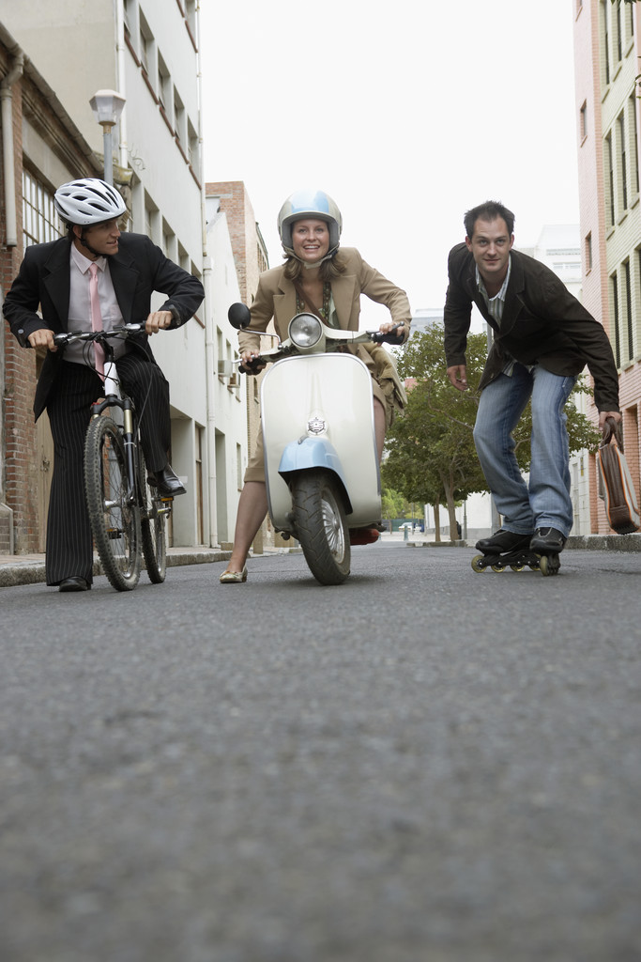
Discussing the performance measures, establishes the ground rules for your audience for how they will be able to tell a good solution from a bad one and most importantly be able to appreciate the value of your project.
Bike Performance Measures
Notes:
In order reach that 5% we had to determine what performance measures might a potential commuting cyclist evaluate any option on, which included

Slide 20
Bike Performance Measures
10% Cargo / Rider Weight Limit
20% Peak Output
-- (top speed, max incline, commuter time)
15% Duration / Range
10% User Effort / Efficiency
5% Reliability / Maintenance
-- (time, freq., cost)
30% Cost
5% Vehicle Weight (trade-off)
5% Environmental Impact
Safety
We could have broken this slide into more slides, highlighting each bullet as its mentioned. However we go though the list very quickly as soon as it pops up, so the audience is likely to read it along with us. As a reveal of each bullet would take just a little bit of extra time with each reveal, we’re able to go through this list a little faster. It’s also easy to understand material and the partial slide reveal is already used a good amount in this presentation so this is an acceptable use of going through the whole list quickly
Notes:
How much can it carry,
How fast can it go up an incline
How far can it go
How much effort is required of the user
How much goes into maintaining it
And of course how much does it cost
Other measures could be included things like the weight of the actual bike and the environmental impact, but criteria like safety were not included here. Criteria like safety were instead represented by go / no-go requirements to ensure we do not induce any safety concerns that are not already found in a bicycle.

Slide 21
The purpose of this next set of slides is to help the audience understand the general purpose of the various major components of the system come together to create the desired end system/effect.
Notice very few details about how any of these subsystems actually work are described yet. But it will be much easier to talk about how each subsystem works, now that the audience has an understanding of the overall system
How it All Works
Preset Bicycle Characteristics
Breaking Detection
Filtered
Wheel Rotation
Wheel Force
Sensor
System
Wheel Rotation
Wheel Force
Sensor
Filters
Demand
Algorithm
Desired Speed
Rider & Cargo Weight
Energy
Demand
(Attaches to)
Actual Speed
Est. Travel Distance
User Input Need
Perpetual Motion
Controller
(PMC)
Standard
Bicycle
(Attaches to)
User Interface
Device
Available Energy
Desired Motor
Output
Energy Input
(via rider)
Energy
Storage
System
Motor
Actuation
System
Supplied Energy
Energy Input
(via wall outlet)
Actual Motor
Output
Notes:
The system itself is pretty complex but can be thought of

Slide 22
How it All Works
Preset Bicycle Characteristics
Bike Speed vs. Desired Speed
Breaking Detection
Filtered
Wheel Rotation
Wheel Force
Sensor
System
Wheel Rotation
Wheel Force
Sensor
Filters
Demand
Algorithm
Desired Speed
Rider & Cargo Weight
Energy
Demand
(Attaches to)
Actual Speed
Est. Travel Distance
User Input Need
Perpetual Motion
Controller
(PMC)
Standard
Bicycle
(Attaches to)
User Interface
Device
Available Energy
Desired Motor
Output
Energy Input
(via rider)
Energy
Storage
System
Motor
Actuation
System
Supplied Energy
Energy Input
(via wall outlet)
Actual Motor
Output
Notes:
as a set of filtered sensors that compares the bike’s actual speed to the rider’s desired speed. Then the real magic happens where

Slide 23
The purpose of this set of slides is to help the audience understand the general purpose of the various major components of the system come together to create the desired end system/effect.
Notice very few details about how any of these subsystems actually work are described yet. But it will be much easier to talk about how each subsystem works, now that the audience has an understanding of the overall system
How it All Works
Preset Bicycle Characteristics
Bike Speed vs. Desired Speed
Breaking Detection
Filtered
Wheel Rotation
Wheel Force
Sensor
System
Wheel Rotation
Wheel Force
Sensor
Filters
Demand
Algorithm
Desired Speed
Rider & Cargo Weight
Energy
Demand
(Attaches to)
Smart Energy Input
Actual Speed
Est. Travel Distance
User Input Need
Perpetual Motion
Controller
(PMC)
Standard
Bicycle
(Attaches to)
User Interface
Device
Available Energy
Desired Motor
Output
Energy Input
(via rider)
Energy
Storage
System
Motor
Actuation
System
Supplied Energy
Energy Input
(via wall outlet)
Actual Motor
Output
Notes:
the bike intelligently runs a Perpetual Motion Controller,

Slide 24

The purpose of this set of slides is to help the audience understand the general purpose of the various major components of the system come together to create the desired end system/effect.
Notice very few details about how any of these subsystems actually work are described yet. But it will be much easier to talk about how each subsystem works, now that the audience has an understanding of the overall system
How it All Works
Preset Bicycle Characteristics
Bike Speed vs. Desired Speed
Breaking Detection
Filtered
Wheel Rotation
Wheel Force
Sensor
System
Wheel Rotation
Wheel Force
Sensor
Filters
Demand
Algorithm
Desired Speed
Rider & Cargo Weight
Energy
Demand
(Attaches to)
Smart Energy Input
Actual Speed
Est. Travel Distance
User Input Need
Perpetual Motion
Controller
(PMC)
Standard
Bicycle
(Attaches to)
User Interface
Device
Available Energy
Desired Motor
Output
Energy Input
(via rider)
Energy
Storage
System
Motor
Actuation
System
Supplied Energy
Energy Input
(via wall outlet)
Actual Motor
Output
Notes:
on an onboard Intel Atom, that makes use of energy from onboard batteries

Slide 25
The purpose of this set of slides is to help the audience understand the general purpose of the various major components of the system come together to create the desired end system/effect.
Notice very few details about how any of these subsystems actually work are described yet. But it will be much easier to talk about how each subsystem works, now that the audience has an understanding of the overall system
How it All Works
Preset Bicycle Characteristics
Bike Speed vs. Desired Speed
Breaking Detection
Filtered
Wheel Rotation
Wheel Force
Sensor
System
Wheel Rotation
Wheel Force
Sensor
Filters
Demand
Algorithm
Desired Speed
Rider & Cargo Weight
Energy
Demand
(Attaches to)
Smart Energy Input
Actual Speed
Est. Travel Distance
User Input Need
Perpetual Motion
Controller
(PMC)
Standard
Bicycle
(Attaches to)
User Interface
Device
Available Energy
Desired Motor
Output
Energy Input
(via rider)
Motor Drives
Energy
Storage
System
Motor
Actuation
System
Supplied Energy
Energy Input
(via wall outlet)
the Bike
Actual Motor
Output
Notes:
to super efficiently drive the motors on the bike.

Slide 26
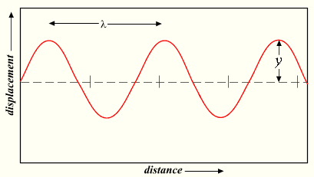
PMC
Novel Tech Explanation
Notes:
The trick to the perpetual motion controls is to realize that everything in the world vibrates and can be thought of as having its own unique sin wave as shown here.

Slide 27
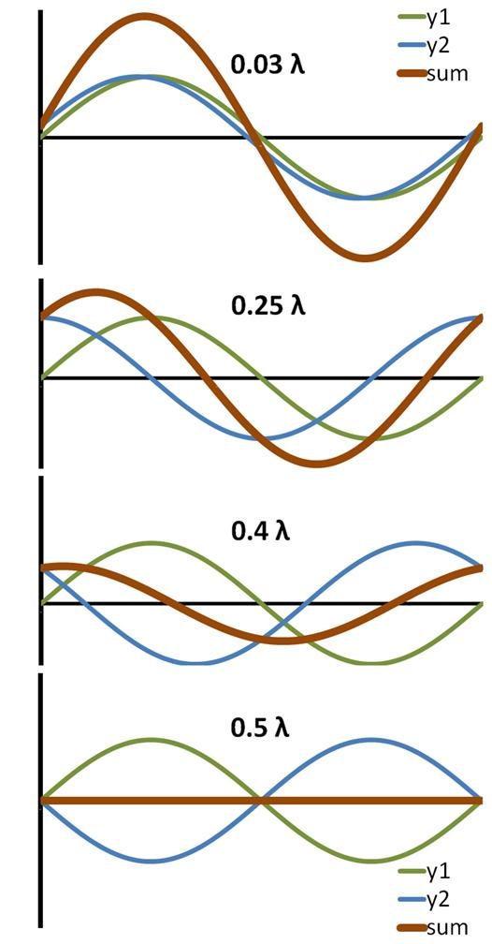
PMC
Novel Tech Explanation
Completely
out of phase
Bike’s Natural Freq.
Energy Input
Resulting Synergy Bike Energy
Notes:
If energy is added off-phase, the peaks of one wave match up with the valleys of the other, the vibrations can cancel each other out.

Slide 28
PMC
Novel Tech Explanation
Completely
out of phase
Synchronization
Process
Bike’s Natural Freq.
Energy Input
Resulting Synergy Bike Energy
Notes:
But as the added energy becomes more in-phase, known as beginning to synchronize, the overall added energy can be greater.
So if you know how the bike naturally vibrates, which our system continually monitors, you can add energy to the system at just the proper rate

Slide 29
PMC
Novel Tech Explanation
Completely
out of phase
Synchronization
Process
Bike’s Natural Freq.
Energy Input
Resulting Synergy Bike Energy
Notes:
so that you’re resulting energy is quite large, hence driving your Synergy bike even more efficiently. This final super efficient operational state is called

Slide 30
PMC
Novel Tech Explanation
Completely
out of phase
Synchronization
Process
PMC
Harmonics Achieved
Bike’s Natural Freq.
Energy Input
Resulting Synergy Bike Energy
Notes:
PMC harmonics, but as you’ll see the synchronization process is really the critical stage because if not done properly it can cause the bike to have painfully slow accelerations and poor efficiencies during accelerations.

Slide 31
Making it Real
In this short of a presentation, you can really only hope to give the general impression on how you carried out your work. But showing that an abbreviated timeline (or other forms of a timeline like a Gantt chart) is available, shows that you were at least organized to some degree – this impression can be given in other ways but a timeline works fine here.
.
Timeline Summary
Task | Time Period
Problem & Needs Definition | September
Use Case & Functional Analysis | September
Subsystem Definition | September
Component Selection | October
Establish Test Cases | October – Nov.
Perpetual Motion Control (PMC) | October – Nov.
Sensor + Bike, Sensor + Filter, Sensor + Filter + Bike | November
Exercise Bike Prototype Housing | November
Low Level Motor Control | November – Dec.
Documentation | November – Dec.
1st Motor / PMC / Demand Alg. Integration Tests | November – Dec.
Notes:
Throughout the semester we followed a sequential development of building up subsystems and testing them and then testing the subsystems together. By semester’s end,

Slide 32
Making it Real
It is not expected that our audience has time to read this whole list (nor do we really want them to as we would prefer they listen to what we’re saying) so we quickly move to highlighting a part of the list. For those who may be interested, showing the existence of a timeline is enough to help them be able to ask for more details later on if they want them.
Please see the Presentation Tips & Tricks guide for more details on how to handle large amounts of information on slides
Timeline Summary
Task | Time Period
Problem & Needs Definition | September
Use Case & Functional Analysis | September
Subsystem Definition | September
Component Selection | October
Establish Test Cases | October – Nov.
Perpetual Motion Control (PMC) | October – Nov.
Sensor + Bike, Sensor + Filter, Sensor + Filter + Bike | November
Exercise Bike Prototype Housing | November
Low Level Motor Control | November – Dec.
Documentation | November – Dec.
1st Motor / PMC / Demand Alg. Integration Tests | November – Dec.
Notes:
we had a our sensor system completed

Slide 33
Making it Real
Timeline Summary
Task | Time Period
Problem & Needs Definition | September
Use Case & Functional Analysis | September
Subsystem Definition | September
Component Selection | October
Establish Test Cases | October – Nov.
Perpetual Motion Control (PMC) | October – Nov.
Sensor + Bike, Sensor + Filter, Sensor + Filter + Bike | November
Exercise Bike Prototype Housing | November
Low Level Motor Control | November – Dec.
Documentation | November – Dec.
1st Motor / PMC / Demand Alg. Integration Tests | November – Dec.
Notes:
and a combined demand algorithm, PMC, and motor system, all connected to a self-standing exercise bike.

Slide 34
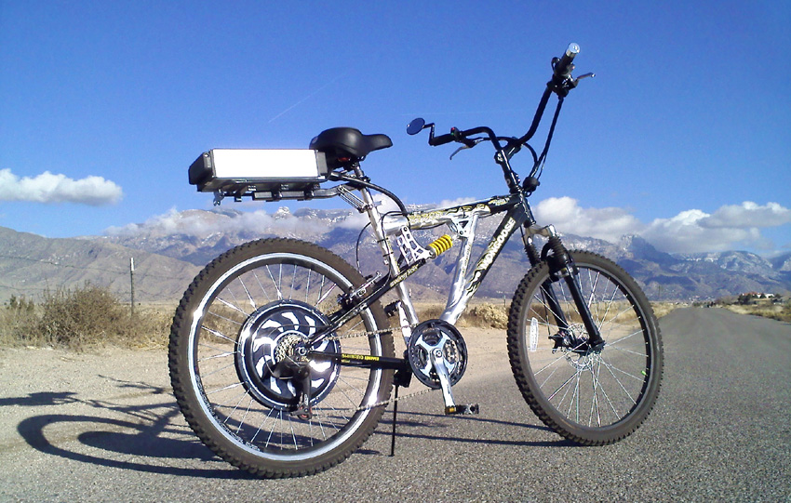
Making it Real
Placeholder Image to be replaced in final: http://image.made-in-china.com/4f0j00lvzTkDHMabcf/Electric-Bike-Motor.jpg
Notes:
Shown here.
By varying the friction on the exercise bike’s wheel we were able to test this system as a partially and fully loaded bike of a max combined capacity of rider, bike and cargo of up to 300 lbs, to accommodate local shopping as well, and a max maintained speed of up to 20 mph – the maximum speed allowed by law for a motorized bike to still be considered a bike.
We tested the system in a long flat street scenario as a baseline, a flat stop & go scenario to simulate city traffic, and a hilly section with a max incline of 10% -- the max incline of most towns in the US.

Slide 35
The PMC is fictional, so obviously the data presented here is too. The argument does start out a little technical but this is okay as one it helps those audience who may have a little more knowledge and hence might give them more insight However, even if the reader isn’t as knowledgeable about the topic, you as the audience should still be able to understand what the significance of what the results are that are being shown and begin to gain insight as to why something is good or bad. The same is true for the real projects that you are doing. Your audience, despite being experts in their own areas, may not be familiar at all with the technology you are presenting. So it is your job and responsibility to present the information in a way that anyone can understand. – DO NOT ASSUME THAT YOUR AUDIENCE WILL ALREADY BE FAMILIAR WITH YOUR TECHNOLOGY – even if they are your boss or have years of more experience than you. In the professional world, typically nobody is a better expert on your project than you are.
Performance Improvements
PMC Output
Time
Notes:
The initial performance was not stellar as shown here in the PMC output graph for an acceleration from stop to the desired max speed test.

Slide 36
The presenter here offers some more technical information (such as the reference to the “second order underdamped response”) . This information may be helpful to perhaps a controls experts in the audience. However notice that the presenter also summarizes this for the average viewer, (i.e. it’s a strange looking behavior but its normal for this kind of work). Then as the presentation goes forward, on this slide and some of the next, the results are presented in a way that explains their meaning to an average viewer
Performance Improvements
Overshoot =
Excessive Losses
PMC Output
Time
Notes:
The magnitude of the overshoot indicates significant efficiency losses as part of a long synchronization stage.

Slide 37
The PMC is fictional, so obviously the data presented here is too. The argument does start out a little technical but this is okay as one it helps those audience who may have a little more knowledge and hence might give them more insight However, even if the reader isn’t as knowledgeable about the topic, you as the audience should still be able to understand what the significance of what the results are that are being shown and begin to gain insight as to why something is good or bad. The same is true for the real projects that you are doing. Your audience, despite being experts in their own areas, may not be familiar at all with the technology you are presenting. So it is your job and responsibility to present the information in a way that anyone can understand. – DO NOT ASSUME THAT YOUR AUDIENCE WILL ALREADY BE FAMILIAR WITH YOUR TECHNOLOGY – even if they are your boss or have years of more experience than you. In the professional world, typically nobody is a better expert on your project than you are.
Performance Improvements
Long Time to Steady State
PMC Output
Time
Notes:
Furthermore the long time to steady state indicates a slow acceleration that makes the bike seem rather sluggish.
However, thanks to our sequential development process, we were able to recognize how to vary the PMC’s damping

Slide 38
Current Performance
Faster Response
PMC Output
<
+
Better Efficiency
Time
Notes:
and were able to first able to make this improvement. And after significant testing,

Slide 39
Current Performance
Fastest Response
PMC Output
≈
<
+
Best Efficiency
Time
Notes:
we improved it to our current system shown here. Furthermore, if we are able to improve our sensor filtering further with the parts we have currently on order, we have predicted in simulation that we may be able to achieve this further improvement.

Slide 40
Inefficiencies and don’t have the user interface / experience developed and tested well enough
They can justify a change in an original technical target as they are able to show how the modified target will still meeting the intended purpose of the original target just as well.
Bike Performance Measures
 |  | Current Estimate
Cargo/Rider Weight Limit | 10% | 2
Peak Output | 20% | 3
Vehicle Weight | 5% | 4
Duration / Range | 15% | 2
User Effort / Efficiency | 10% | 2
Environmental Impact | 5% | 3
Reliability / Maintenance | 5% | 0
Cost | 30% | 3
 |  | 2.7
The important thing to recognize is that the presentation is showing evidence as to what makes their entry so “cool” is actually working. It may not be fully working yet or working to the point you want it to but that’s what the time between the now and the final presentation is for.
Notes:
Even without considering the simulation though, our current estimated performance already meets or exceeds all of our requirements except the user effort, duration, and cargo weight falling slightly below. The user effort is lower partially due to the fact that we haven’t completed development of our user interface so we can only claim so much at this point. The other major factor is there is more effort required by the rider than we’d like when its fully loaded to 300 lbs, but we believe thanks to the great vehicle weight score this can be addressed.

Slide 41
Inefficiencies and don’t have the user interface / experience developed and tested well enough
They can justify a change in an original technical target as they are able to show how the modified target will still meeting the intended purpose of the original target just as well.
Bike Performance Measures
 |  | Current Estimate
Cargo/Rider Weight Limit | 10% | 2
Peak Output | 20% | 3
Vehicle Weight | 5% | 4
Duration / Range | 15% | 2
User Effort / Efficiency | 10% | 2
Environmental Impact | 5% | 3
Reliability / Maintenance | 5% | 0
Cost | 30% | 3
 |  | 2.7
The important thing to recognize is that the presentation is showing evidence as to what makes their entry so “cool” is actually working. It may not be fully working yet or working to the point you want it to but that’s what the time between the now and the final presentation is for.
Notes:
For the environmental impact criteria, we were able to show we met our goals using the Sustainable Minds software focusing on our battery selection, since batteries are likely to be the largest controllable contributor to the Environmental Impact of the Synergy Bike’s materials.

Slide 42
Inefficiencies and don’t have the user interface / experience developed and tested well enough
They can justify a change in an original technical target as they are able to show how the modified target will still meeting the intended purpose of the original target just as well.
Bike Performance Measures
 |  | Current Estimate
Cargo/Rider Weight Limit | 10% | 2
Peak Output | 20% | 3
Vehicle Weight | 5% | 4
Duration / Range | 15% | 2
User Effort / Efficiency | 10% | 2
Environmental Impact | 5% | 3
Reliability / Maintenance | 5% | 0
Cost | 30% | 3
 |  | 2.7
The important thing to recognize is that the presentation is showing evidence as to what makes their entry so “cool” is actually working. It may not be fully working yet or working to the point you want it to but that’s what the time between the now and the final presentation is for.
Notes:
For the reliability criteria though, we gave ourselves a zero score currently as we don’t have enough data yet to make any claim on this but certainly will by the project’s end.

Slide 43
Inefficiencies and don’t have the user interface / experience developed and tested well enough
They can justify a change in an original technical target as they are able to show how the modified target will still meeting the intended purpose of the original target just as well.
Bike Performance Measures
 |  | Current Estimate | End Projection
 |  |  | Low | High
Cargo/Rider Weight Limit | 10% | 2 | 3 | 3
Peak Output | 20% | 3 | 4 | 5
Vehicle Weight | 5% | 4 | 4 | 4
Duration / Range | 15% | 2 | 4 | 5
User Effort / Efficiency | 10% | 2 | 3 | 5
Environmental Impact | 5% | 3 | 3 | 3
Reliability / Maintenance | 5% | 0 | 3 | 3
Cost | 30% | 3 | 3 | 3
 |  | 2.7 | 3.4 | 3.95
The important thing to recognize is that the presentation is showing evidence as to what makes their entry so “cool” is actually working. It may not be fully working yet or working to the point you want it to but that’s what the time between the now and the final presentation is for.
Notes:
We believe though that our final system will have a performance ranging between 3.4 and 3.95, meeting all of our targets and it really depends upon just how well we can get our PMC and directly related systems to operate.
On a 5 point scale, these still may seem a little low but one has to remember that if everything met our targets, the bike would receive a score of a 3, so even a 3.4 is pretty good.

Slide 44
Inefficiencies and don’t have the user interface / experience developed and tested well enough
They can justify a change in an original technical target as they are able to show how the modified target will still meeting the intended purpose of the original target just as well.
Bike Performance Measures
 |  | Current Estimate | End Projection |  | Competitors
 |  |  | Low | High | Top Perf.
Cargo/Rider Weight Limit | 10% | 2 | 3 | 3 | 4
Peak Output | 20% | 3 | 4 | 5 | 5
Vehicle Weight | 5% | 4 | 4 | 4 | 5
Duration / Range | 15% | 2 | 4 | 5 | 4
User Effort / Efficiency | 10% | 2 | 3 | 5 | 2
Environmental Impact | 5% | 3 | 3 | 3 | 2
Reliability / Maintenance | 5% | 0 | 3 | 3 | 4
Cost | 30% | 3 | 3 | 3 | 0
 |  | 2.7 | 3.4 | 3.95 | 2.75
The important thing to recognize is that the presentation is showing evidence as to what makes their entry so “cool” is actually working. It may not be fully working yet or working to the point you want it to but that’s what the time between the now and the final presentation is for.
Notes:
This becomes even more evident when comparing our system to current electric bicycles. If we take at the top-of-line competitor we can see that this system would only receive a 2.75 as it costs more than many cars but it would also require more human effort in uphill areas for our target trip duration

Slide 45
Inefficiencies and don’t have the user interface / experience developed and tested well enough
They can justify a change in an original technical target as they are able to show how the modified target will still meeting the intended purpose of the original target just as well.
Bike Performance Measures
 |  | Current Estimate | End Projection |  | Competitors
 |  |  | Low | High | Top Perf. | Cost Eff.
Cargo/Rider Weight Limit | 10% | 2 | 3 | 3 | 4 | 1
Peak Output | 20% | 3 | 4 | 5 | 5 | 2
Vehicle Weight | 5% | 4 | 4 | 4 | 5 | 3
Duration / Range | 15% | 2 | 4 | 5 | 4 | 2
User Effort / Efficiency | 10% | 2 | 3 | 5 | 2 | 1
Environmental Impact | 5% | 3 | 3 | 3 | 2 | 3
Reliability / Maintenance | 5% | 0 | 3 | 3 | 4 | 3
Cost | 30% | 3 | 3 | 3 | 0 | 3
 |  | 2.7 | 3.4 | 3.95 | 2.75 | 2.25
The important thing to recognize is that the presentation is showing evidence as to what makes their entry so “cool” is actually working. It may not be fully working yet or working to the point you want it to but that’s what the time between the now and the final presentation is for.
Notes:
When looking at cost comparable competitors, the best we could find rated at only a 2.35 performance. The difference here showing almost a 50% increase in performance from the competitors to our end projection really helps to emphasis the benefit that the PMC system of the Synergy Bike can bring to our identified challenge.

Slide 46
Team Synergy Bike
THANK
YOU
Questions?
Notes:
So as you can see the Synergy Bike has the potential to make a significant difference in daily commuting and local errand transportaion. We greatly appreciate the time and effort of our advisors and sponsors, especially the Intel-Cornell Cup and thank you for your time and interest in the Synergy Bike.

